Slide 1

Third Year Bachelor of Technology
In
Electronics and telecommunication Engineering
School Of Electrical Engineering
Prof. Vinayak Kulkarni
(Project Mentor)
Krishnakant Kumar [T217003]
Akshay Kapase [T217042]
Dhiraj Patil [T217080]
Shrihari Eknathe [T217100]

Slide 2
UAV For Low payload Delivery
Major Project

Slide 3
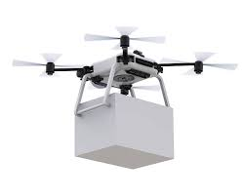
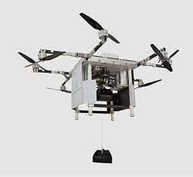
Introduction
There are limitations on deliveries by road
“Unmanned Aerial Vehicle”(UAV) can be used to deliver life essential products(LOW payload)
It is latest technology and increases delivery efficiency and accuracy
UAV work automatically with the help of Embedded system integrated with GPS, accelerometers, gyrometers and other sensors implemented on it
It uses Vision System for obstacle detection

Slide 4
Problem Statement and Objective
To design, develop and fabricate an autonomous Unmanned Aerial Vehicle (UAV) for the delivery of life essential goods.
Objectives:
Sem 1: Structural Design of UAV
Sem 2: Delivery Mechanism Design
Sem 3: Design, Implementation and Evaluation

Slide 5
Literature Survey Table
No | Name | Author | Publish Year | Discussion
1 | Survey on Computer Vision for UAVs: Current Developments and Trends | Christoforos Kanellakis George Nikolakopoulos | Received: 28 April 2016 / Accepted: 15 January 2017 / Published online: 27 January 2017 | Overview on the challenges addressed and future trends in autonomous agent development will be provided.
2 | Computer Vision Onboard UAVs for Civilian Tasks | Pascual Campoy Juan F. Correa | Received: 15 March 2008 / Accepted: 30 June 2008 / Published online: 7 August 2008 | This paper focuses on UAVs maneuver in space using Visual information as main input source.
3 | Autonomous Transportation and Deployment with Aerial Robots for Search and Rescue Missions | Konstantin Kondak | Received 26 November 2010; accepted 20 May 2011 Published Year: 12 October 2011 | In this paper, outdoor field experiments of transportation and accurate deployment of loads with single/multiple autonomous aerial vehicles are presented
4 | Generic Slung Load Transportation System Using Small Size Helicopters | Markus Bernard, Konstantin Kondak | Received: 12 May 2009/ Accepted: 17 May 2009 / Published online: 6 July 2009 | Overview of techniques and approaches used for a load transportation system based on small size unmanned helicopters.

Slide 6
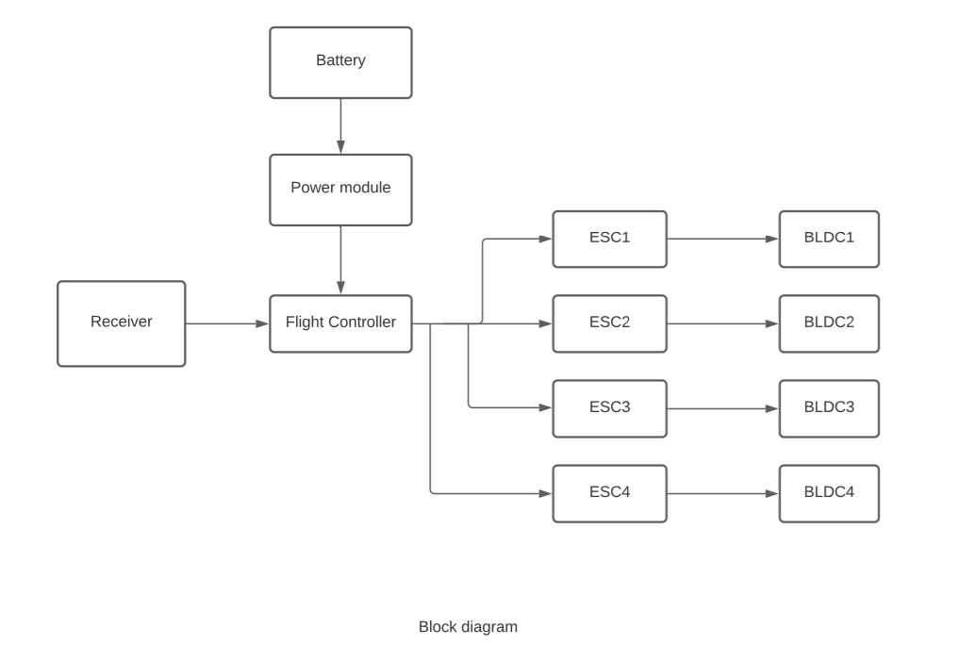
Block Diagram

Slide 7
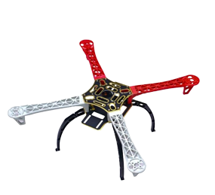
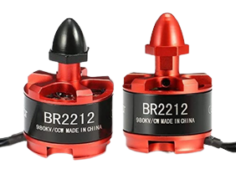
Hardware Requirements
Specification
Description
 |  | Built from high quality glass fiber and ultra durable polyamide nylon. Arms are reinforced and much more stronger to prevent and reduce breakage. Integrated PCB connections for direct soldering your ESCs. Colored arms for orientation to keep you flying in the right direction.
 |  | Stable Performance. The design of the 2212920KV is capable of withstanding competitional conditions. Comes in the compact size.
Model | F450 Frame
Weight (gm) | 296 gm
Dimensions (mm) | 450 x 55 x 55
Quadcopter Frame
Model | DJI 2212 920KV Brushless DC Motor
Weight (gm) | 60 gm
Maximum Thrust | 500
BLDC Motors

Slide 8
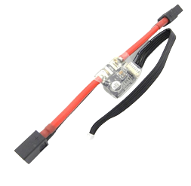
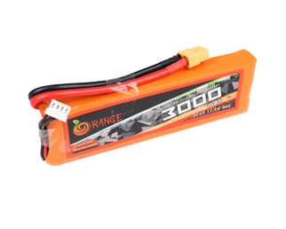
Specification
Description
 |  | Good Temperature Control. Minimum weight in Class The Orange LiPo battery has matched resistance.
Model | 30A SimonK Procedure Brushless ESC
Weight (gm) | 25 gm
Dimensions (mm) | 50x23x8
Drive current | 30 A
To change the signal frequency range to the value you want
Highest efficiency 100% N-FET design.
Highest accuracy with Crystal Oscillator
Electronic Speed Controller
Model | Orange 3300mAh 3S 35C/80C Lithium Polymer Battery Pack (LiPo)
Weight (gm) | 260 gm
Dimensions (mm) | 40 x 43 x 20
voltage | 11.1V
Battery

Slide 9
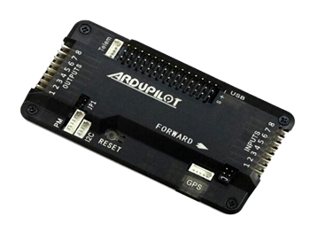
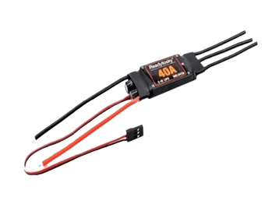
Specification
Description
Model | APM 2.8
Weight (gm) | 82
Dimensions (mm) | 70 x 45 x 15
The flight controller uses the data gathered by the sensors to calculate the desired speed for each of the four motors. The flight controller sends this desired speed to the Electronic Speed Controllers (ESC’s), which translates this desired speed into a signal that the motors can understand.
Flight Controller
It is used to prevent high voltage towards the Esc’s and pass the required voltage which is essential.
It allows you to run your receiver, servos, and other accessories from your main battery without using a separate lower voltage one.
Switching regulator outputs 5.3V and 3A max.
Model | APM/Pixhawk Power Module
Weight (gm) | 24
Max Current Sensing | 90 Amp
Power Module

Slide 10
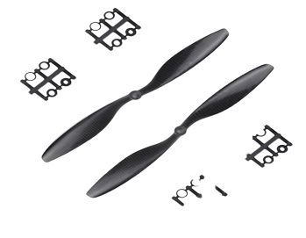
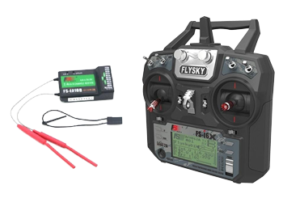
Specification
Description
 |  | To generate thrust and in accordance to the size of frame.
 |  | For RC communication For manual flight , initial calibaration and taking manual control if anything goes wrong
Model | 1045 Propeller
Weight (gm) | 14
Diameter (mm) | 25.4cm
Propellers
Model | FlySky Transmitter With FS-iA6B Receiver
RF Range | 2.40-2.48GHz
Bandwidth | 500 KHz
Frequency Range | 2.4055--2.475GHZ
Transmitting Power | ≤ 20dBm
RC transmitter receiver

Slide 11
Thrust and Battery Capacity calculation
Thrust by single A2212 1000 KV BLDC Motor is 800 gm.
So, for 4 motors,
4*800=3200 gm
Total thrust by motor is 3200 gm.

Slide 12
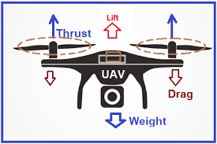
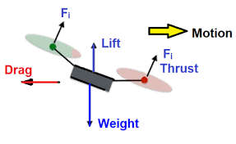
Thrust to weight ratio:
Thrust = 3200 = 2.06
Weight 1553 1
i.e 2.06 : 1

Slide 13
Battery Drain time calculation
Current output from battery = 3300 mAh
Total current consumption of all component’s = 20.6 Amp
Battery endurance = current O/P from battery
Total current consumption
= 3300 x 10⁻³ x 60
20.6
Battery endurance = 9.6 minutes
= approx. 10 minute (AT 100%)
Material | Current Required
Motor | 20 Amp
Receiver | 0.1 Amp
Flight controller | 0.1 Amp
ESC (4) | 0.4 Amp
TOTAL | 20.6 Amp

Slide 14
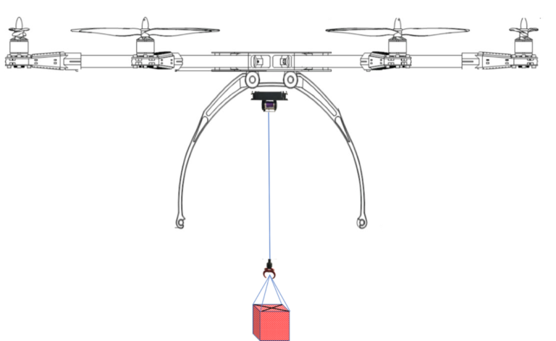

Slide 15
LOAD BALANCING

Slide 16
Why we need load balancing?
Aerial load transportation is an attractive application of UAV.
There are various uncertain disturbances like wind, obstacles, etc which can unbalanced the suspended load.
Load balancing is critical problem for the safety of UAV
If load of UAV cannot balanced then the UAV can crash or other damages may occur

Slide 17
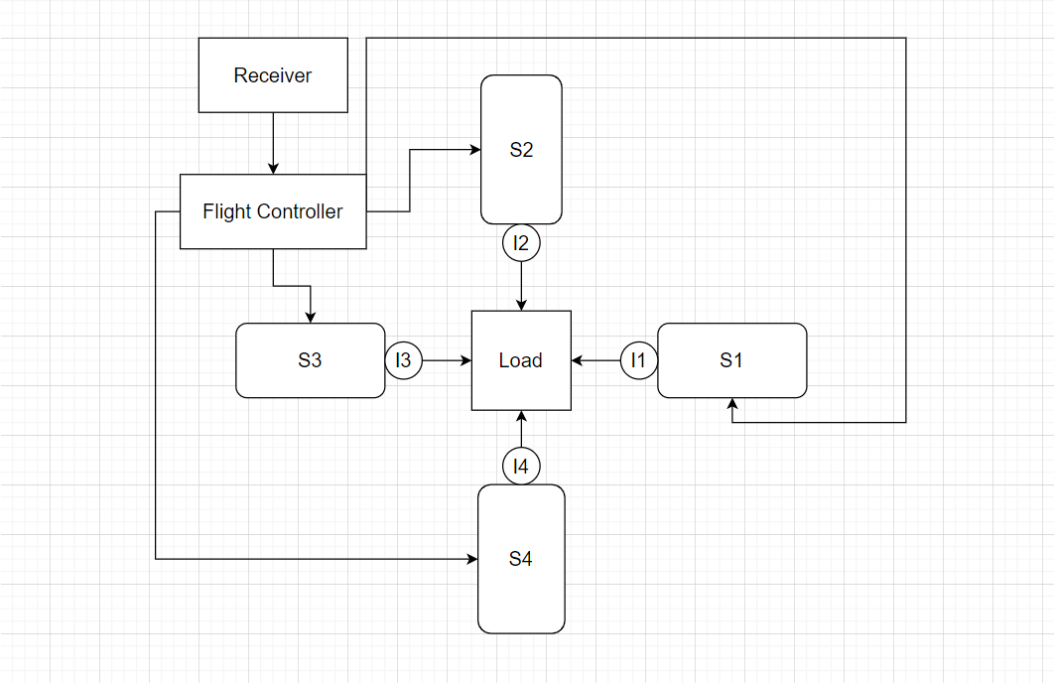
Block Diagram

Slide 18
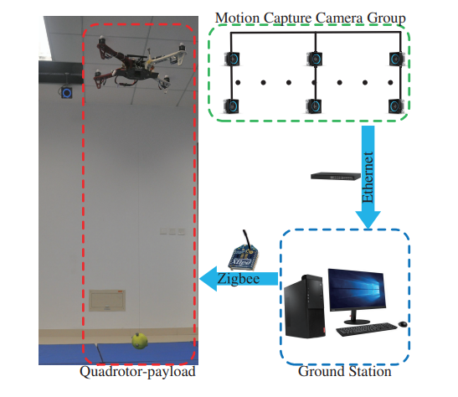
WORKING
The working load balancing mechanism will start during the flight of UAV.
There are four highly sensible IR sensors are used alongside the 4 servo motor to balance the overall load.
This electric components are connected with the flight controller of UAV to get the right signals.
This motors are capable of operating range and maximum torque will be 2.2 kg –cm at 6.6v.
When the IR sensor attached near by the motors will detect the displacement of load the corresponding motor will start rotating.
It will rotate till the load return to its ideal position.

Slide 19
Advantages of load balancing
The primary mission of aerial transportation is to maintain the hanging load within the desired operating and safety limits. Therefore, the prime aim is to design control algorithms that ensure minimal swing angles without sacrificing response times.
The controller takes into account the hanging payload dynamics, the dynamics in three-dimensional space, and the vehicle rotation, achieving a good balance between fast stabilization times and small swing angles.
Neglecting the rotation of the vehicle
Including the payload dynamics, but considering only a longitudinal translation of the UAV.
Reducing the payload swing by sacrificing performance

Slide 20
Drone Weight
Material | Weight
APM | 82 gm
Quadcopter Frame | 330 gm
Electronic Speed Controller ( 4 x 7) | 92 gm
Receiver | 15 gm
Brushless Motor (4 x) | 256 gm
Power Module | 24 gm
Battery (Sky cell 3300 mAh) | 250 gm
Propeller ( 4 x) | 28 gm
Total Weight | 1053 gm
Overall weight of drone
= 1053+ 500 (with payload)
= 1553 gm

Slide 21
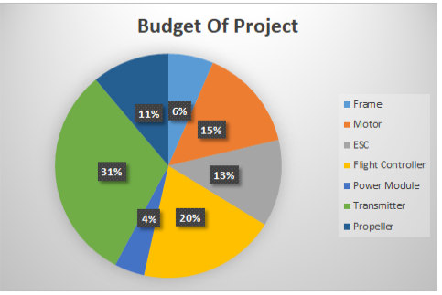
Budget Management

Slide 22
Project Concept
Consumer book his package
Unmanned aerial vehicles used for distributing packages to consumers during the last mile delivery
All necessary tracking is done by GPS
Embedded software navigates the Drone to Customer’s address by their coordinates through GPS
For object detection we use Vision Guided System
As product reaches to coordinates by GPS, the customer will receive an OTP
If the product is successfully delivered, the customer will acknowledge by providing the correct OTP.
If there is any failure in delivering package, UAV send SMS of failure and it will fly to vendor’s control centre.

Slide 23
Conclusion and Future Scope
The total UAV specifications and required components are mentioned in the project
Simulation result of UAV flight
Total budget required for building UAV is calculated for overall project
Future scope:
Vision guided system to be implemented for obstacle detection
GPS and other sensors will be added to take control of position of UAV
Delivery mechanism can be implemented
Payload can be increased

Slide 24
References
Kanellakis, Christoforos, and George Nikolakopoulos. "Survey on computer vision for UAVs: Current developments and trends." Journal of Intelligent & Robotic Systems 87.1 (2017): 141-168.
Campoy, Pascual, et al. "Computer vision onboard UAVs for civilian tasks." Journal of Intelligent and Robotic Systems 54.1 (2009): 105-135.
Bernard, Markus, et al. "Autonomous transportation and deployment with aerial robots for search and rescue missions." Journal of Field Robotics 28.6 (2011): 914-931.
Bernard, Markus, and Konstantin Kondak. "Generic slung load transportation system using small size helicopters." 2009 IEEE International Conference on Robotics and Automation. IEEE, 2009.
Kanellakis, Christoforos, and George Nikolakopoulos. "Survey on computer vision for UAVs: Current developments and trends." Journal of Intelligent & Robotic Systems 87.1 (2017): 141-168.
Merkert, Rico, and James Bushell. "Managing the drone revolution: A systematic literature review into the current use of airborne drones and future strategic directions for their effective control." Journal of air transport management 89 (2020): 101929.

Slide 25
THANK YOU

